Slide 1


Intro to Linear programming
Optimization:
Intro to Linear programming
Notes:
Jose Cascalho <jose.m.cascalho@gmail.com>, Luis Correia
Luis Reis <lpreis1970@gmail.com>, Luis Reis <lpreis1970@gmail.com>, Pedro Cardoso <pcardoso@ennor.org>, Hélia Guerra <helia@uac.pt>
In this talk I’d like to give you my vision on the new, exciting field of computational sustainability.
3 Let me start with a bit of background on sustainability

Slide 2
Optimization: Mathematical Program
Optimization problem in which the objective and constraints are given as mathematical functions and functional relationships.
Minimize f(x₁, x₂, …, x_{n})
Subject to:
g₁(x₁, x₂, …, x_{n}) = , , b₁
g₂(x₁, x₂, …, x_{n}) = , , b₂
…
g_{m}(x₁, x₂, …, x_{n}) = , , b_{m}

Slide 3
Linear Programming (LP)
Linear – all the functions are linear
Ex: f (x₁, x₂, …, x_{n})= c₁x₁ + c₂ x₂ + … c_{n} x_{n}
Programming – does not refer to computer programming but rather “planning” - planning of activities to obtain an optimal result i.e., it reaches the specified goal best (according to the mathematical model) among all feasible alternatives.

Slide 4
Components of a Linear Programming Model
A linear programming model consists of:
A set of decision variables
A (linear) objective function
A set of (linear) constraints

Slide 5
Nature Connection: Recreational Sites
Nature Connection is planning two new public recreational sites: a forested wilderness area and a sightseeing and hiking park. They own 80 hectares of forested wilderness area and 20 hectares suitable for the sightseeing and hiking park but they don’t have enough resources to make the entire areas available to the public. They have a budget of $120K per year. They estimate a yearly management and maintenance cost of $1K per hectare for the forested wilderness area, and $4K per hectare for the sightseeing and hiking park. The expected average number of visiting hours a day per hectare are: 10 for the forest and 20 for the sightseeing and hiking park.
Question: How many hectares should Nature Connection allocate to the public sightseeing and hiking park and to the public forested wilderness area, in order to maximize the amount of recreation, (in average number of visiting hours a day for the total area to be open to the public, for both sites) given their budget constraint?

Slide 6
Steps in setting up a LP
Determine and label the decision variables.
Determine the objective and use the decision variables to write an expression for the objective function.
Determine the constraints - feasible region.
Determine the explicit constraints and write a functional expression for each of them.
Determine the implicit constraints (e.g., nonnegativity constraints).

Slide 7
Formulation of the problem as a Linear Program
1 Decision Variables
x1 – # hectares to allocate to the public forested wilderness area
X2 – # hectares to allocate the public sightseeing and hiking park
2 Objective Function
Max 10 x1 + 20 x2
3 Constraints
x1 <= 80
x2 <= 20
x1 + 4 x2 <= 120
x1 >= 0; x2 >= 0 Non-negativity constraints

Slide 8
Formulation of the problem as a Linear Program
Nature Connection is planning two new public recreational sites: a forested wilderness area and a sightseeing and hiking park. They own 80 hectares of forested wilderness area and 20 hectares suitable for the sightseeing and hiking park but they don’t have enough resources to make the entire areas available to the public. They have a budget of $120K per year. They estimate a yearly management and maintenance cost of $1K per hectare, for the forested wilderness area, and $4K per hectare for the sightseeing and hiking park. The expected average number of visiting hours a day per hectare are: 10 for the forest and 20 for the sightseeing and hiking park.
Question: How many hectares should Nature Connection allocate to the public sightseeing and hiking park and to the public forested wilderness area, in order to maximize the amount of recreation, (in average number of visiting hours a day for the total area to be open to the public, for both sites) given their budget constraint?
1 Decision Variables
x1 – # hectares to allocate to the public forested wilderness area
X2 – # hectares to allocate the public sightseeing and hiking park
2 Objective Function
Max 10 x1 + 20 x2
3 Constraints
x1 <= 80 Land for forest
x2 <= 20 Land for Park
x1 + 4 x2 <= 120 Budget
x1 >= 0; x2 >= 0 Non-negativity constraints

Slide 9
X2 - Park
x1 <= 80
Max 10 x1 + 20 x2
x1 <= 80
x2 <= 20
x1 + 4 x2 <= 120
x1 >=0; x2 >= 0
50
30
x1 + 4 x2 <= 120
20
x2 <= 20
10
Feasible Region
80
100
120
20
40
60
x1 Forest

Slide 10
X2 - Park
The vector representing the
gradient of the objective
function is:
Max 10 x1 + 20 x2
x1 <= 80
x2 <= 20
x1 + 4 x2 <= 120
x1 >=0; x2 >= 0
50
30
20
10
Feasible Region
80
100
120
20
40
60
x1 Forest

Slide 11
X2 - Park
The vector representing the
gradient of the objective
function is:
Max 10 x1 + 20 x2
x1 <= 80
x2 <= 20
x1 + 4 x2 <= 120
x1 >=0; x2 >= 0
50
Isobenefit lines (for different forest and park areas)
30
10 x1 + 20 x2 = c
x2 = - ½ x1 + c
20
10
Z = 600
80
100
120
20
40
60
x1 Forest

Slide 12
X2 - Park
The vector representing the
gradient of the objective
function is:
Max 10 x1 + 20 x2
x1 <= 80
x2 <= 20
x1 + 4 x2 <= 120
x1 >=0; x2 >= 0
50
Isobenefit lines (for different forest and park areas)
30
x2 = - ½ x1 + c
20
10
Z* = 10 (80) + 20 (10) = 1000
Z = 200
Z = 600
80
100
120
20
40
60
x1 Forest

Slide 13
Summary of the Graphical Method
Draw the constraint boundary line for each constraint. Use the origin (or any point not on the line) to determine which side of the line is permitted by the constraint.
Find the feasible region by determining where all constraints are satisfied simultaneously.
Determine the slope of one objective function line (perpendicular to its gradient vector). All other objective function lines will have the same slope.
Move a straight edge with this slope through the feasible region in the direction of improving values of the objective function (direction of the gradient). Stop at the last instant that the straight edge still passes through a point in the feasible region. This line is the optimal objective function line.
A feasible point on the optimal objective function line is an optimal solution.

Slide 14
No Feasible Solutions – Why?
X2 - Park
x1 <= 80
Max 10 x1 + 20 x2
x1 <= 80
x2 <= 20
x1 + 4 x2 <= 120
x1 + x2 >= 100
x1 >=0; x2 >= 0
50
30
x1 + 4 x2 <= 120
20
x2 <= 20
10
Feasible Region
80
100
120
20
40
60
x1 Forest

Slide 15
Multiple Optimal Solutions – Why
X2 - Park
x1 <= 80
Max x1 + 4 x2
x1 <= 80
x2 <= 20
x1 + 4 x2 <= 120
x1 >=0; x2 >= 0
50
Isoprofit lines (for different forest and park areas)
30
x1 + 4 x2 <= 120
x2 = - 4 x1 + c
20
x2 <= 20
10
80
100
120
20
40
60
x1 Forest

Slide 16
Unbounded – Why?
X2 - Park
Z = 440
Z = 320
Max x1 + 4 x2
x1 <= 80
x1 <= 80
x1, x2 >=0
30
20
10
Z = 120
80
120
x1 Forest

Slide 17
Key Categories of LP problems:
Resource-Allocation Problems
Cost-benefit-trade-off problems
Distribution-Network Problems
Mixed problems

Slide 18
Second Example: Keeping the river clean
Cost-benefit-trade-off problems
Choose the mix of levels of various activities to
achieve minimum acceptable levels for various
benefits
at a minimum cost.

Slide 19
Second Example: Keeping the River Clean
A pulp mill in Maine makes mechanical and chemical pulp, polluting the river in which it spills its spent waters. This has created several problems, leading to a change in management.
The previous owners felt that it would be too expensive to reduce pollution, so they decided to sell the pulp mill. The mill has been bought back by the employees and local businesses, who now own the mill as a cooperative. The new owners have several objectives:
1 – to keep at least 300 people employed at the mill (300 workers a day);
2 – to generate at least $40,000 of revenue a day
They estimate that this will be enough to pay operating expenses and yield a return that will keep the mill competitive in the long run. Within these limits, everything possible should be done to minimize pollution.
Both chemical and mechanical pulp require the labor of one worker for 1 day (1 workday, wd) per ton produced;
Mechanical pulp sells at $100 per ton; Chemical pulp sells at $200 per ton;
Pollution is measured by the biological oxygen demand (BOD). One ton of mechanical pulp produces 1 unit of BOD; One ton of chemical pulp produces 1.5 units of BOD.
The maximum capacity of the mill to make mechanical pulp is 300 tons per day; for chemical pulp is 200 tons per day. The two manufacturing processes are independent (I.e., the mechanical pulp line cannot be used to make chemical pulp and vice versa).

Slide 20
Pollution, employment, and revenues result from the production of both types of pulp. So a natural choice for the variables is:
Decision Variables
X1 amount of mechanical pulp produced (in tons per day, or t/d) and
X2 amount of chemical pulp produce (in tons per day, or t/d
Min Z = 1 X1 + 1.5 X2
(BOD/day) (BOD/t) (t/d) (BOD/t) (t/d)
Subject to:
1 X1 + 1 X2 >= 300 Workers/day
(wd/t) (t/d) (wd/t)(t/d)
100 X1 + 200 X2 >= 40,000 revenue/day
($/t) (t/d) + ($/t)(t/d) $/d
X1 <= 300 (mechanical pulp)
(t/d) (t/d)
X2 <= 200 (mechanical pulp)
(t/d) (t/d)
X1 >=0; X2 >= 0

Slide 21
Distribution Network Problems

Slide 22
Distribution-Network Problem
The International Hospital Share Organization is a non-profit organization that refurbishes a variety of used equipment for hospitals of developing countries at two international factories (F1 and F2). One of its products is a large X-Ray machine.
Orders have been received from three large communities for the X-Ray machines.

Slide 23
Some Data
 | Shipping Cost for Each Machine (Model L)
To | Community 1 | Community 2 | Community 3
From |  |  |  | Output
Factory 1 | $700 | $900 | $800 | 12 X-ray machines
Factory 2 | 800 | 900 | 700 | 15 X-Ray machines
Order Size | 10 X-ray machines | 8 X-Ray machines | 9 X-Ray machines
Question: How many X-Ray machines (model L) should be shipped from each factory to each hospital so that shipping costs are minimized?
Notes:
Table 4.5 Some data for the Big M Company distribution-network problem

Slide 24
The Distribution Network
10 Model L
needed
$700/machine
$700/machine
12 Model L
$900/machine
$800/machine
8 Model L
needed
$800/machine
$900/machine
15 Model L
$700/machine
9 Model L
needed
Question: How many machines (model L) should be shipped from each factory to each customer so that sipping costs are minimized?
Notes:
Figure 4.4 The distribution network for the Big M Company problem.

Slide 25
Activities – shipping lanes (not the level of production which has already been defined)
Level of each activity – number of machines of model L shipped through the corresponding shipping lane.
Best mix of shipping amounts
Example:
Requirement 1: Factory 1 must ship 12 machines
Requirement 2: Factory 2 must ship 15 machines
Requirement 3: Customer 1 must receive 10 machines
Requirement 4: Customer 2 must receive 8 machines
Requirement 5: Customer 3 must receive 9 machines

Slide 26
Algebraic Formulation
Let S_{ij} = Number of machines to ship from i to j (i = F1, F2; j = C1, C2, C3). Minimize Cost = $700S_{F1-C1} + $900S_{F1-C2} + $800S_{F1-C3} + $800S_{F2-C1} + $900S_{F2-C2} + $700S_{F2-C3}
subject to S_{F1-C1} + S_{F1-C2} + S_{F1-C3} = 12 S_{F2-C1} + S_{F2-C2} + S_{F2-C3} = 15 S_{F1-C1} + S_{F2-C1} = 10 S_{F1-C2} + S_{F2-C2} = 8 S_{F1-C3} + S_{F2-C3} = 9 and S_{ij} ≥ 0 (i = F1, F2; j = C1, C2, C3).

Slide 27
Algebraic Formulation
Let S_{ij} = Number of machines to ship from i to j (i = F1, F2; j = C1, C2, C3). Minimize Cost = $700S_{F1-C1} + $900S_{F1-C2} + $800S_{F1-C3} + $800S_{F2-C1} + $900S_{F2-C2} + $700S_{F2-C3}
subject to Factory 1: S_{F1-C1} + S_{F1-C2} + S_{F1-C3} = 12 Factory 2: S_{F2-C1} + S_{F2-C2} + S_{F2-C3} = 15 Customer 1: S_{F1-C1} + S_{F2-C1} = 10 Customer 2: S_{F1-C2} + S_{F2-C2} = 8 Customer 3: S_{F1-C3} + S_{F2-C3} = 9 and S_{ij} ≥ 0 (i = F1, F2; j = C1, C2, C3).

Slide 28
Terminology and Notation

Slide 29
Terminology of solutions in LP model
Solution – not necessarily the final answer to the problem!!!
Feasible solution – solution that satisfies all the constraints
Infeasible solution – solution for which at least one of the constraints is violated
Feasible region – set of all points that satisfies all the constraints (possible to have a problem without any feasible solutions)
Binding constraint – the left-hand side and the right-hand side of the constraint are equal, I.e., constraint is satisfied in equality. Otherwise the constraint is nonbinding.
Optimal solution – feasible solution that has the best value of the objective function.
Largest value → maximization problems
Smallest value → minimization problems
Multiple optimal solutions, no optimal solutions, unbounded Z

Slide 30
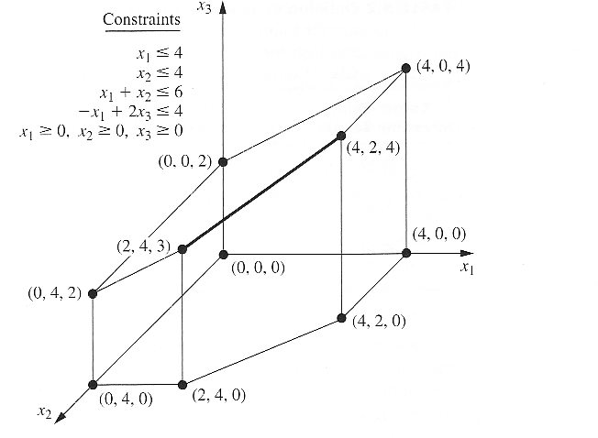
3D feasible region

Slide 31
Solving linear programs

Slide 32
Solution Methods for Linear Programs
Simplex Method
Optimum must be at the intersection of constraints
Intersections are easy to find, change inequalities to equalities
x₂
c^{T}
x₁

Slide 33
Solution Method for Linear Programs
Interior Point Methods
Benefits
Scales Better than Simplex
x₂
-c^{T}
x₁

Slide 34
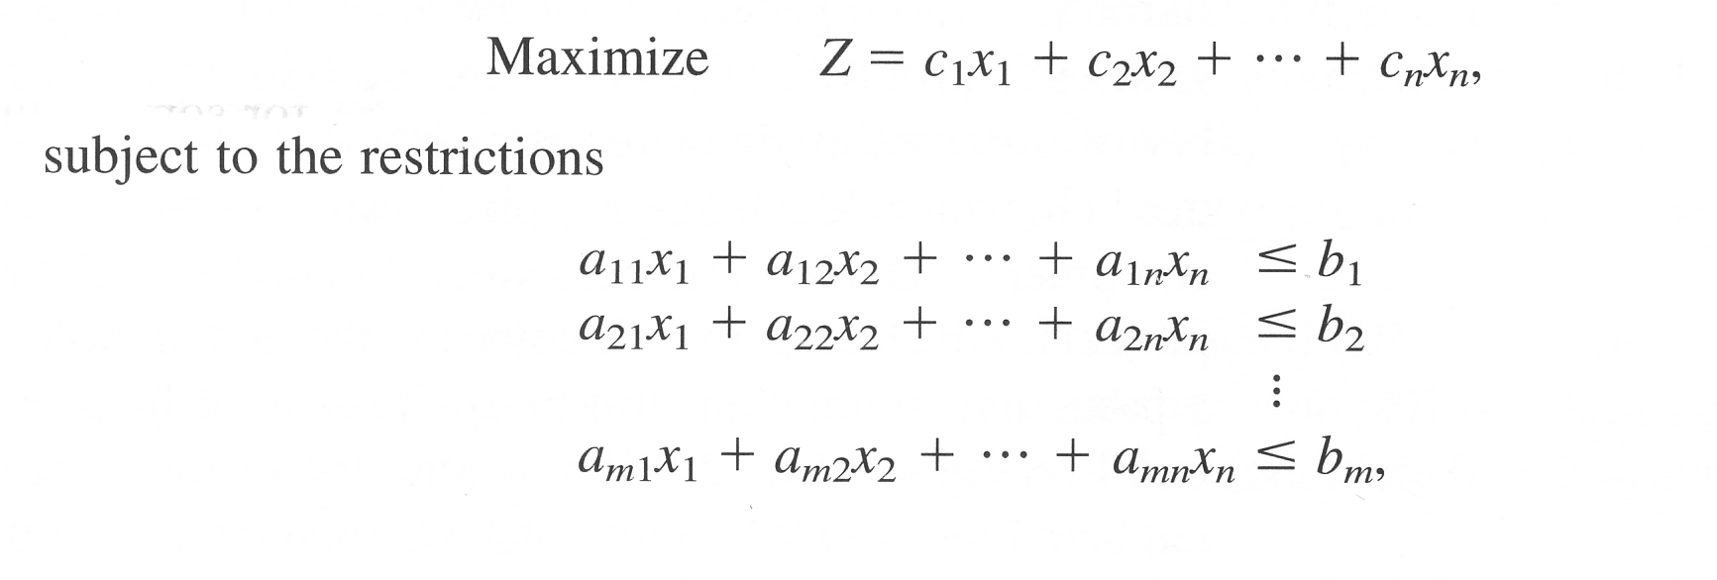
Standard form of the LP model
x_{i} >= 0 , (i =1,2,…,n)
Other variants:
Maximize Z (instead of minimizing Z; but Min Z = - Max -Z)
Some constraints have other signs (=; and >= )
Some variables have unrestricted sign, i.e., they are not subject to the non-negativity constraints

Slide 35
Solving Linear Programs
Is equivalent to

Slide 36
Regression with absolute loss

